Slide 1

Marketing Analytics Report

Slide 2

GROUP 3 TEAM MEMBERS :
AKHIL SABU ABRAHAM
SRINIVASU MURALI KANTAMNENI
MEKALA SATISH KUMAR
RUCHITA UDAY TIBDEWAL
ABHISHEK
RATTAN KUMAR.I

Slide 3
SUMMARY
KPI LIST
EXCEL
TABLEAU
POWER BI
SQL
KEY TAKE AWAY

Slide 4

SUMMARY
By leveraging the insights derived from the dataset and dashboard, stakeholders can significantly elevate operational efficiency, optimize quality control protocols, reduce costs, and empower informed decision-making to propel manufacturing excellence.
Benefits: This approach facilitates comprehensive performance monitoring, enabling the swift identification of issues and fostering a culture of data-driven decision-making. As a result, organizations can enhance productivity, streamline processes, and achieve strategic objectives with precision.

Slide 5
SUMMARY
DASHBOARD OVER-VIEW:
Purpose: To analyze and optimize marketing campaigns and web engagement through data-driven insights.
To understand audience behavior, campaign effectiveness, and traffic sources for strategic decision-making..
Key Features: Monitors service data to enhance guest satisfaction and operational efficiency. Provides actionable insights for evaluating performance and facilitating data-driven decision-making.

Slide 6

Kpi- list
Marketing Analysis Overview Total Activity: 10,000+ interactions recorded. Engagement Rate: 67.11%, indicating a high level of audience interaction. Click-Through Rate (CTR): 33.01%, showcasing campaign effectiveness. Open Rate: 34.10%, reflecting email marketing reach. Delivery Rate: 32.89%, ensuring messages reach targeted audiences. | Web Engagement Analysis Overview Unique Visitors: 12M visitors recorded. Bounce Rate: 55.31%, highlighting areas for improvement. Average Session Duration: 8.05 minutes, indicating content engagement.

Slide 7
Campaign Performance Insights Top Performing Campaigns: Breakdown of highest engagement campaigns. Email Sent vs Activity Timeline: Trends over the months showing peaks and drops. Total Activity by Campaign: Comparative analysis of campaigns based on engagement. Activity Breakdown by Type: Percentage share of opened, clicked, and delivered emails. Audience Engagement User Interaction Trends: Identifies peak periods of audience engagement. Demographic Insights: Breakdown of audience distribution by region and preference. Behavioral Analysis: Click behavior, email open patterns, and conversion rates. Recommendations: Strategies for improving engagement and retention.

Slide 8
Web Traffic Insights Visitors by Region: Analysis of top-performing regions (Korea, Congo, Bhutan, etc.). Traffic Source Breakdown: Percentage share of Paid Ads, Referrals, Organic Search, Direct, and Social Media. Session Trends: Monthly variation in unique visitors and page views. Device Type Analysis: Segmentation of desktop, mobile, and tablet users. User Behavior & Interaction Conversion Rates: Understanding how visitors interact with the site. Bounce Rate Insights: Identifying reasons for high bounce rates. Engagement Flow: User journey analysis from landing pages to conversions. Recommendations: Enhancing site design, optimizing call-to-actions, and improving navigation.

Slide 9

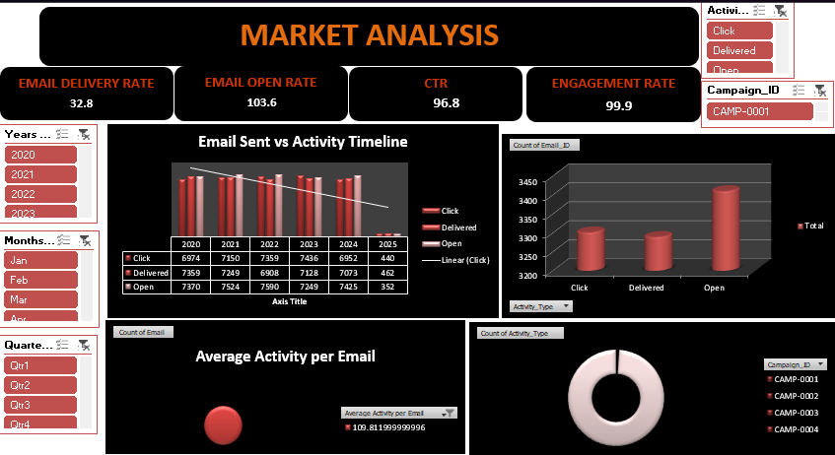
Excel marketing dashboard

Slide 10
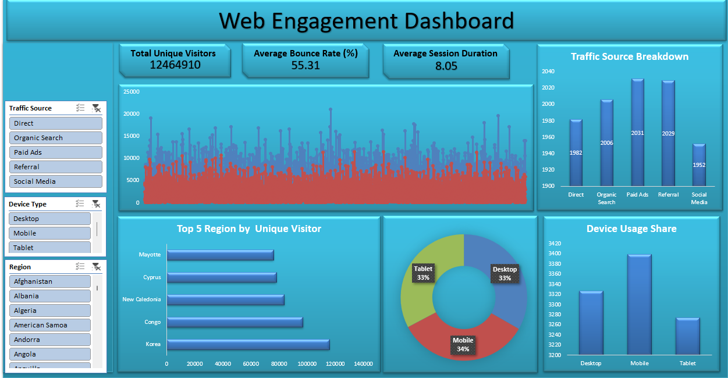
Excel web engagement dashboard

Slide 11
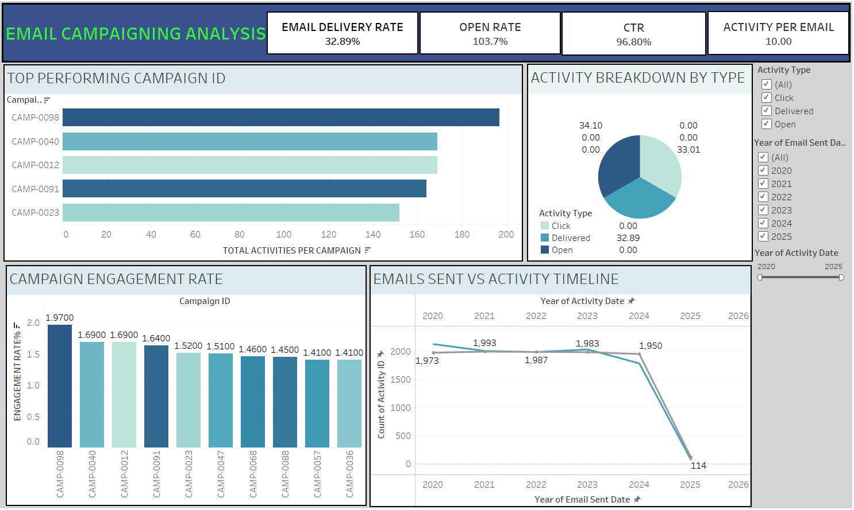
tableau marketing dashboard

Slide 12
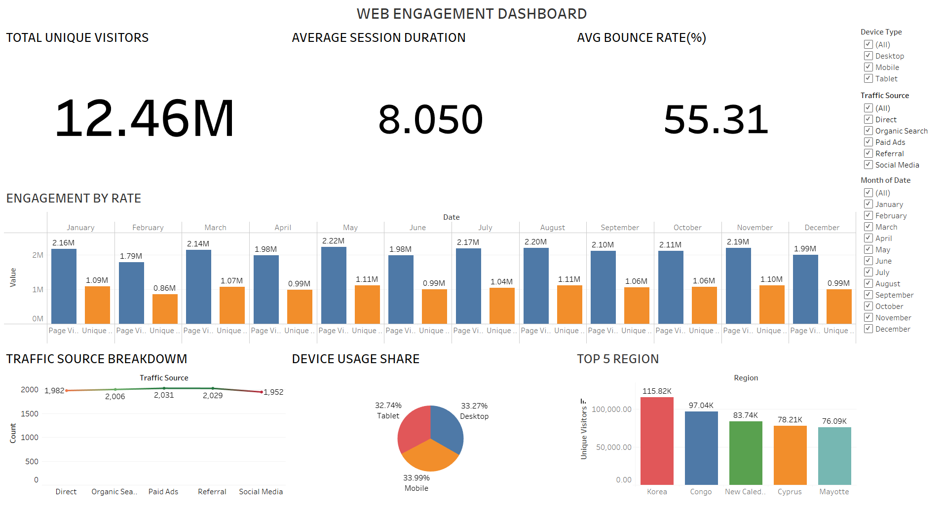
Tableau web engagement dashboard

Slide 13
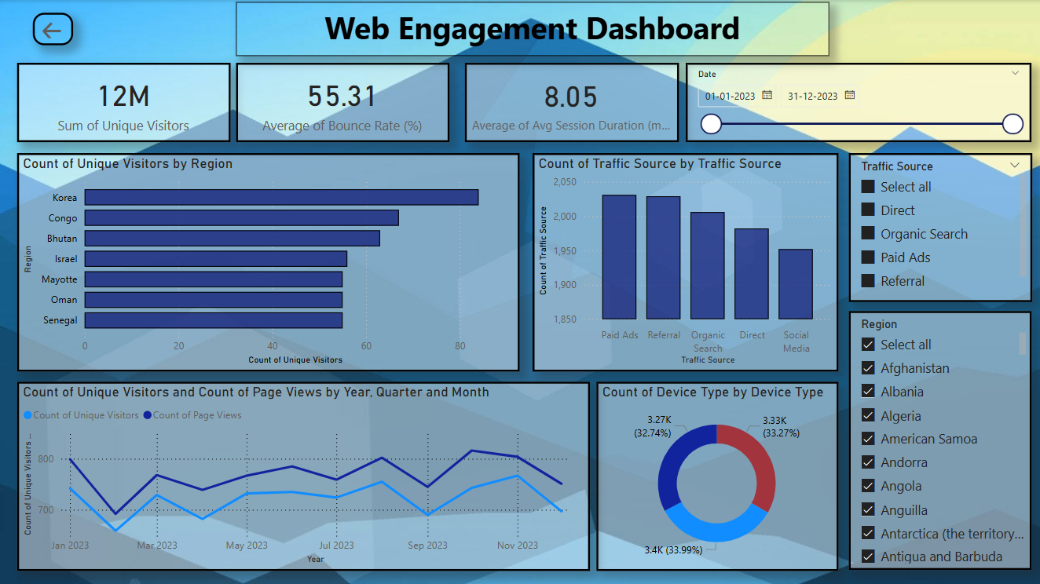
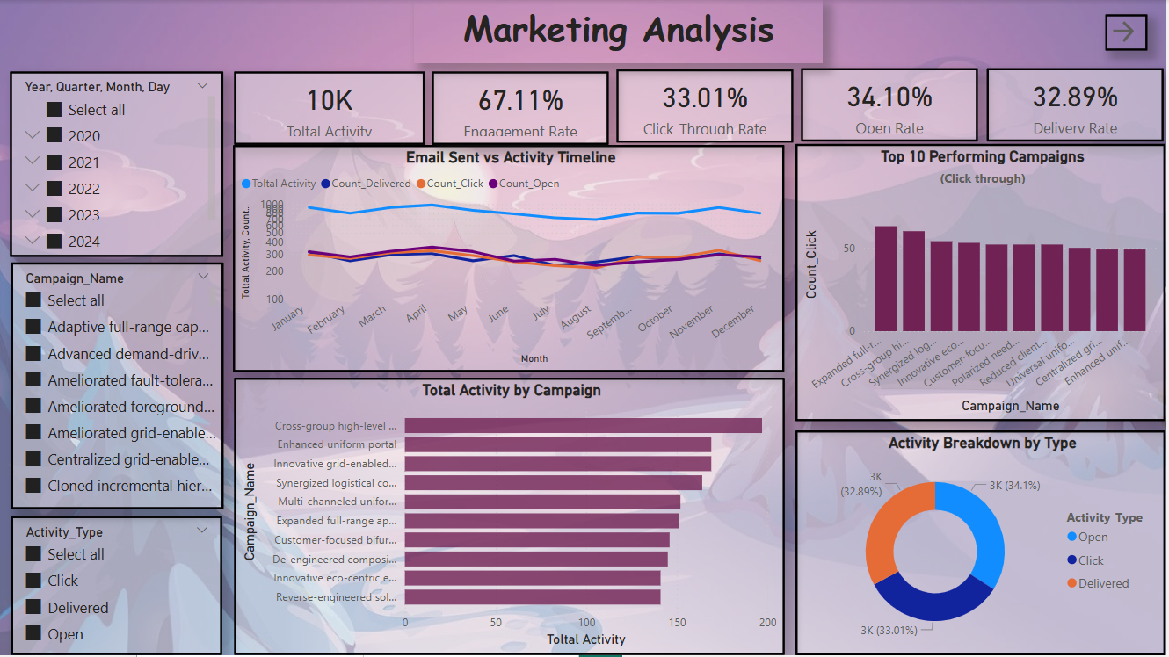
Power bi marketing dashboard

Slide 14
Power bi web engagement dashboard

Slide 15

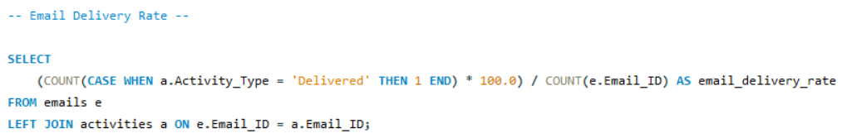
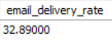
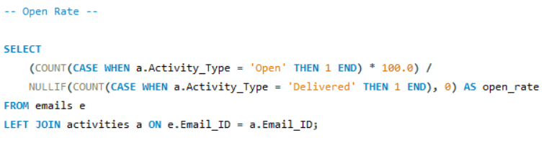
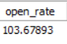
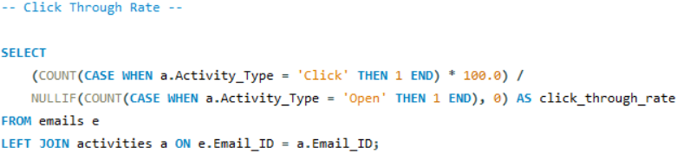
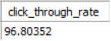
Sql marketing

Slide 16
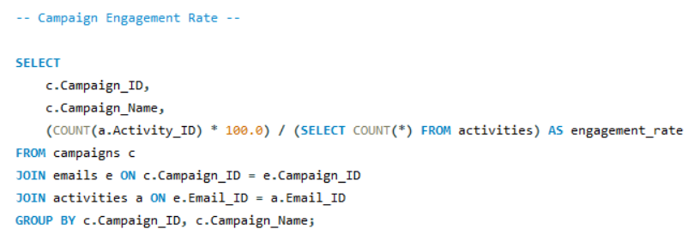
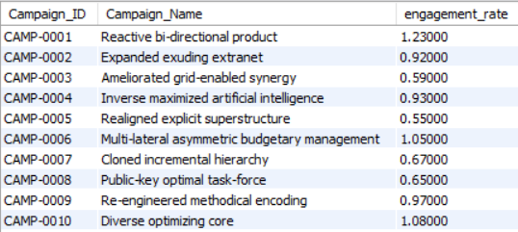
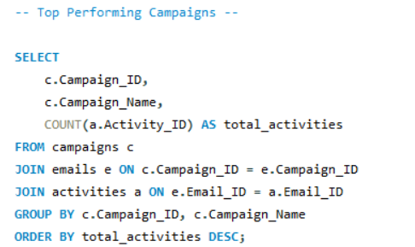
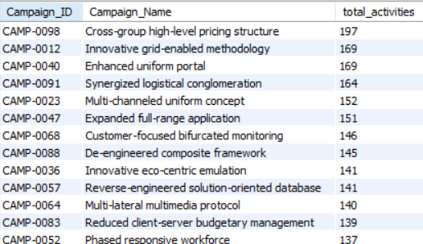
Sql marketing

Slide 17
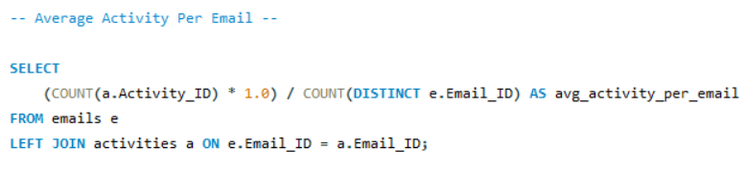
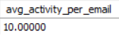
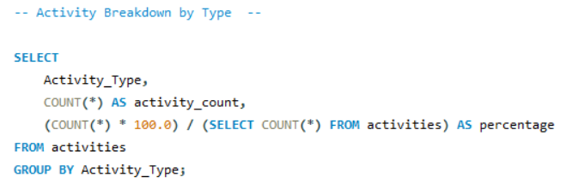
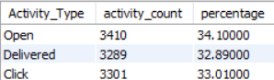
Sql marketing

Slide 18
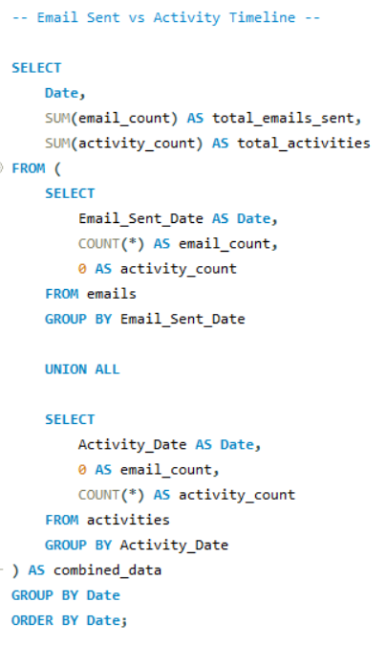
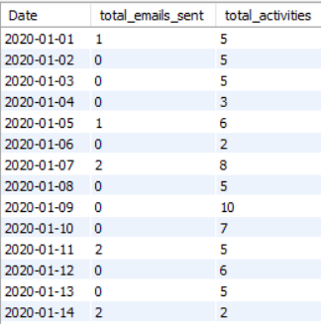
Sql marketing

Slide 19
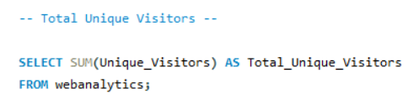
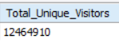
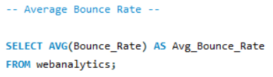
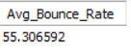
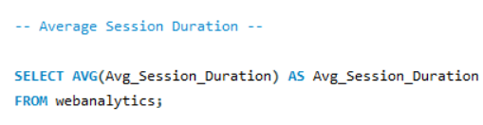
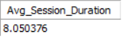
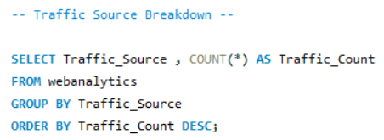
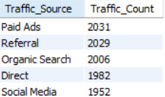
SQL Web engagement

Slide 20
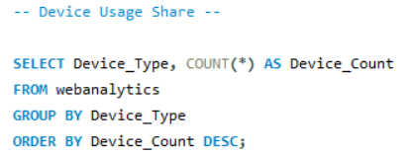
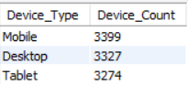
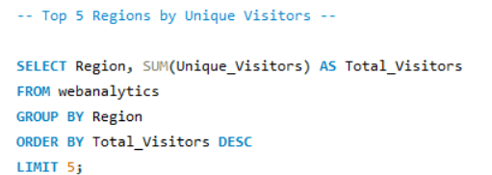
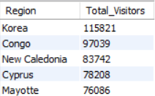
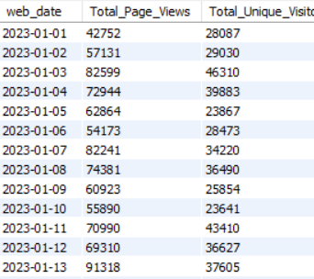
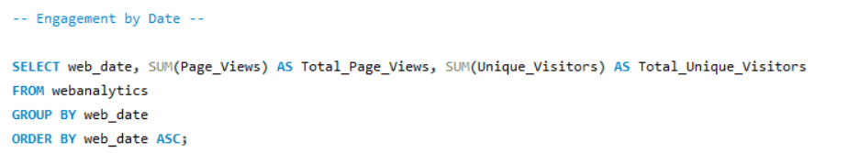
SQL web engagement

Slide 21
KEY TAKE AWAYS
Marketing Success: High engagement and successful campaign reach.
Web Engagement Strengths: Strong organic and paid traffic contribution.
Challenges & Improvements: Reducing bounce rate and increasing session time.
Personalized Campaigns: Need for targeted, data-driven marketing strategies.
Enhanced Content Strategy: Focus on improving content relevance and appeal.
A/B Testing for Optimization: Regular testing to improve campaign efficiency.
Improved Email Deliverability: Strategies to enhance email open and click rates.
Cross-Platform Analysis: Understanding engagement across different channels.
User Retention Strategies: Enhancing loyalty programs and re-engagement tactics.
SEO & Paid Ad Adjustments: Optimizing marketing efforts for better visibility.
Social Media Integration: Expanding reach through interactive and viral content.
Better UX/UI for Web Navigation: Simplifying site design for improved user experience.
Future Roadmap: Implementing AI-driven analytics for predictive insights.

Slide 22

THANK YOU

